Slide 1
Explore Hot Events in Weibo
Lijing Lin Yanghao Li Yining Nie

Slide 2
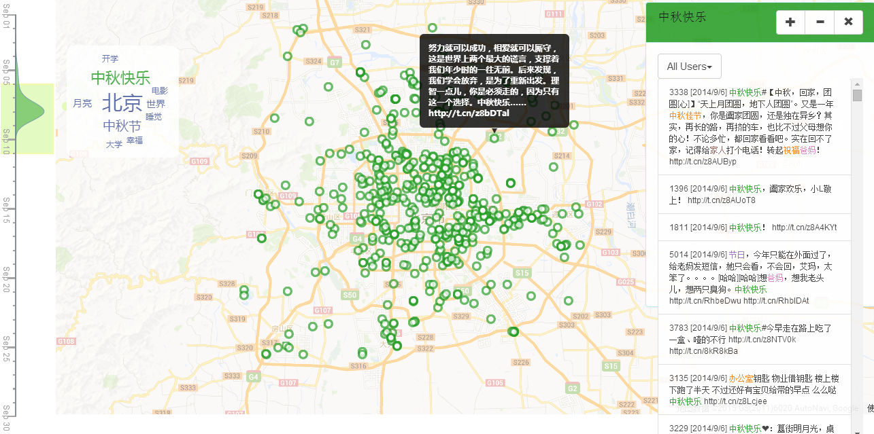
Overview

Slide 3
What it can do?
Hot events in weibo over a period of time
Relation between hot events
Characteristics of geographical distribution of hot events
Relation between top users
Advertising users

Slide 4
Explore Top Events in Weibo
Data
Design
Case Study

Slide 5
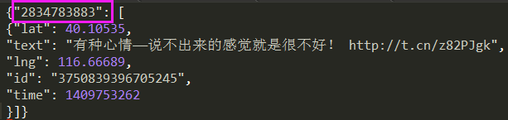
Data
Raw data
Users：6820
Weibos：144191
Time：2014.09.01 – 2014.09.30

Slide 6
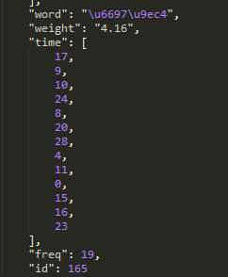
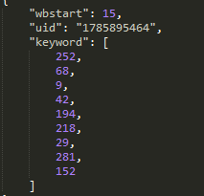
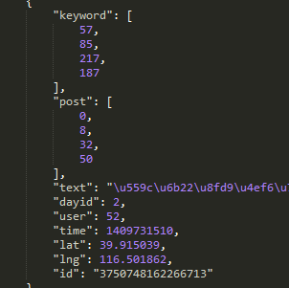
Data Processing
Keyword
Extracting keywords：ICTCLAS
Weight in some time
Weight return ICTCLAS
Frequency in this time
Proportion
Data format
Keywords, Users, Weibos

Slide 7
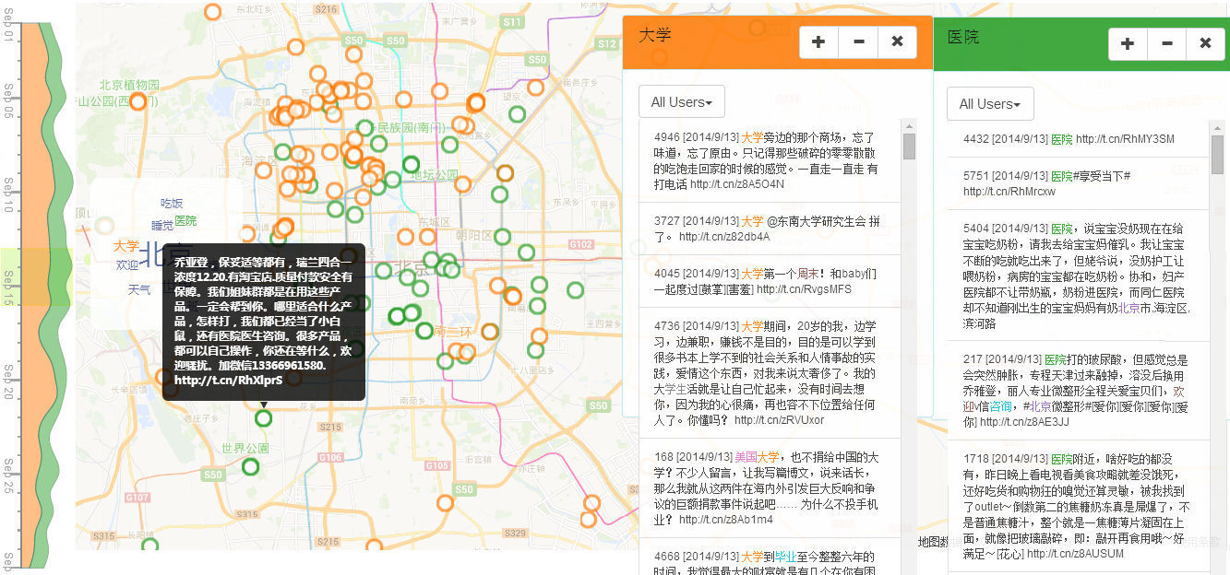
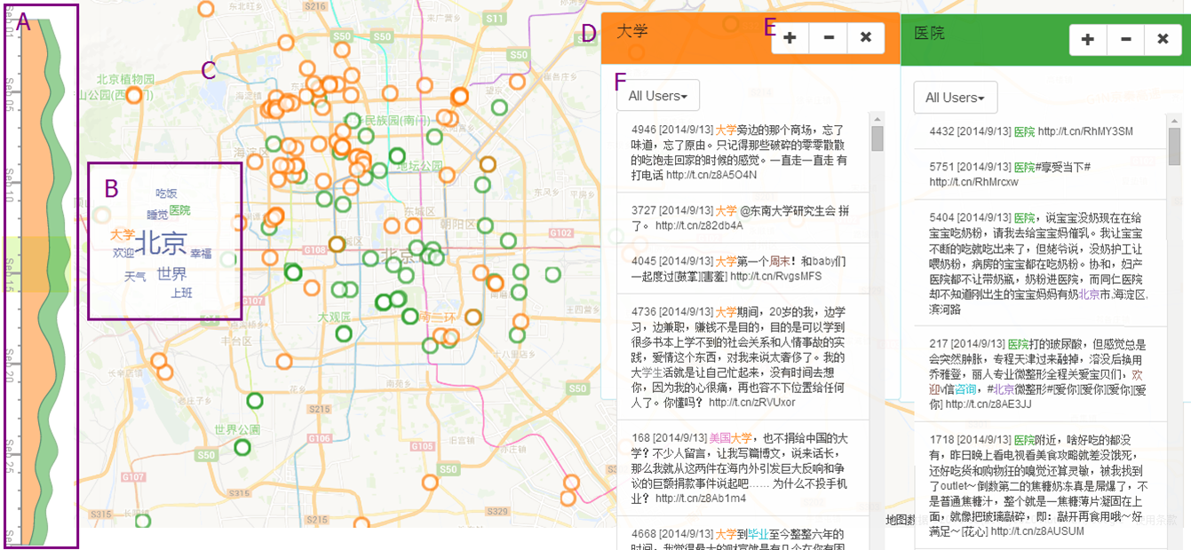
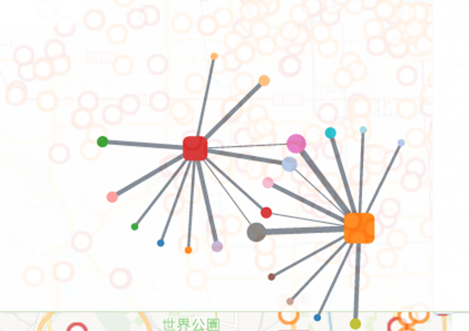
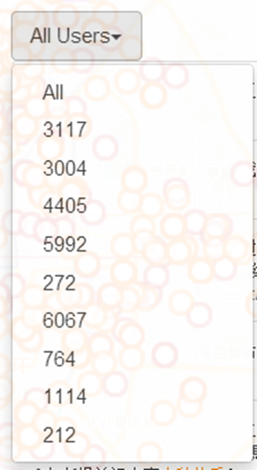
Design

Slide 8
Case Studies

Slide 9
Thank you!!

Slide 10
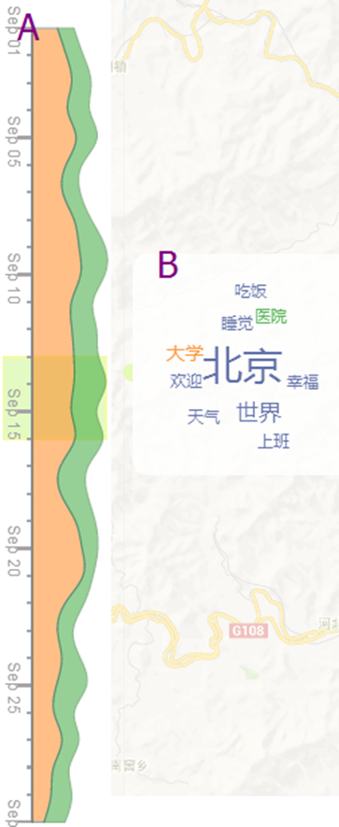
Design
A: keyword river
Compare the change trends between any number of keywords
B：keyword cloud

Slide 11
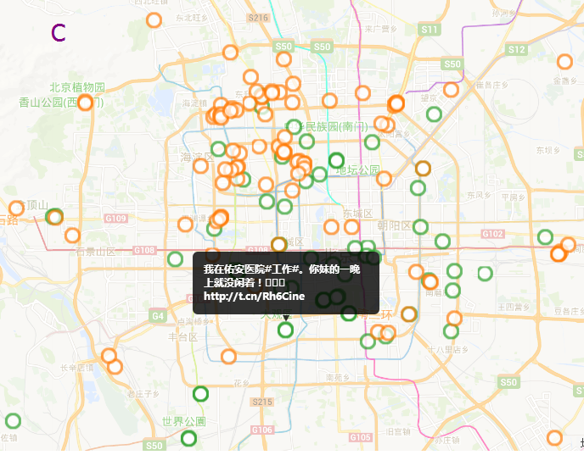
Design

Slide 12
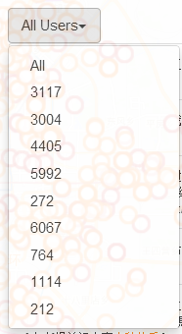
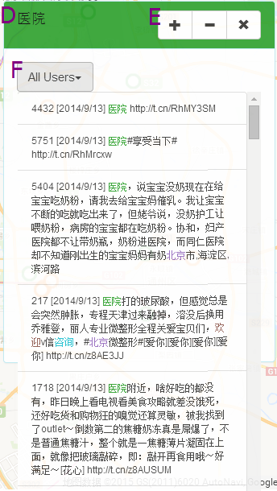
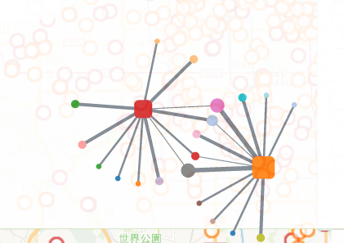
Design
D: keyword – weibo panel
E：Explore the relation between top users
F：Ten top users list

